Slide 1
SQL Review
Lecture 5

Slide 2
Learning Objectives
Refresher
Comparison Microsoft SQL Server to Oracle 11g
Cover some of the improvements and annoyances between the two.
References to learn more on your own.

Slide 3
The Relational Database Model
Tables
Keys
Constraints

Slide 4
Relational Terminology
Table / Relation
Row
Column
Attribute
Null
Primary Key
Candidate Key
Composite Key
Unique Constraint
Check Constraint
Default
Foreign Key
Entity Integrity
Referential Integrity
Categories
CatID
Book
Hardware
Software

Slide 5
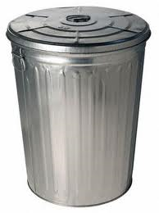

Tables
Metadata
Structured buckets for your data
Columns have data types (physical domain)
Columns have acceptable values (logical domain)

Slide 6


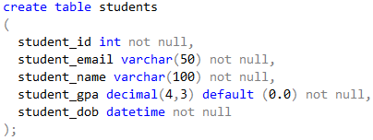
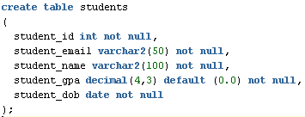
Tables
VS

Slide 7
SQL - Language
Data Definition Language
Data Manipulation Language
Metadata
CREATE
ALTER
DROP
Data
SELECT
INSERT
UPDATE
DELETE

Slide 8
Data Types
VS
SQL Server
Oracle
Id int
State char(2)
Name varchar(50)
Gpa decimal(4,3)
Dob datetime
Resume text
IstMajor bit
Id int
State char(2)
Name varchar2(50)
Gpa decimal(4,3)
Dob date
Resume clob
NO BIT TYPE!!!

Slide 9
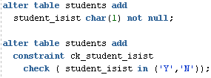
Boolean Types
VS
There is no bit type in oracle.
Workaround:
char(1)
Check constraint

Slide 10

Sequences
VS
There is no int identity in oracle.
You create a sequence object and use the sequence during the insert….

Slide 11
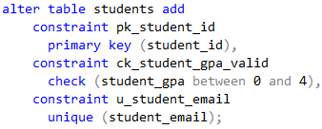
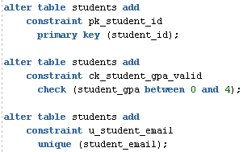
Alter table
VS
You cannot manipulate more than column or constraint with alter table

Slide 12
SQL - Language
Data Definition Language
Data Manipulation Language
Metadata
CREATE
ALTER
DROP
Data
SELECT
INSERT
UPDATE
DELETE

Slide 13
No Auto Commit
VS
SQL Server defaults to “Auto Commit” Mode.
INSERT, UPDATE, and DELETE statements are permanent.
In Oracle they are NOT
You must explicitly COMMIT or ROLLBACK
…How about a few demos?

Slide 14
Varchar2
VS
Why VARCHAR2? Only Oracle knows for sure.
Empty String ‘’ is the same as NULL, in Oracle.
… Demo?

Slide 15

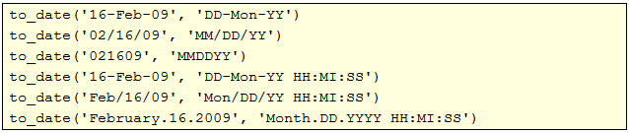
Date Data
VS
To Insert a date value in Oracle you need to use the to_date() function

Slide 16
SELECT Processing
HOW WE SAY IT
HOW IT IS PROCESSED
SELECT (Projection)
DISTINCT
FROM
WHERE
GROUP BY
HAVING
ORDER BY
FROM
WHERE
GROUP BY
HAVING
SELECT (Projection)
ORDER BY
DISTINCT

Slide 17
SELECT - Demos
Aliasing
WHERE
ORDER BY
JOIN
MULTI-TABLE
OUTER
GROUP BY
HAVING

Slide 18
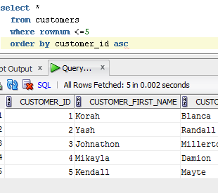
No TOP
VS
Oracle has no TOP clause.
So you need to use an addition to your where clause.

Slide 19
Tools
VS
SQL Server
Oracle
SQL Server Management Studio
SSMS does it all.
Oracle Enterprise Manager, Oracle SQL Developer
OEM is for Database Administration
SQL Dev is for Script and Query Writing

Slide 20
SQL Review
Questions? Comments?

